Slide 1
SIMULATION OF SWITCHING FUNCTIONALITY
TEAM MEMBERS
Koduri Bhavitha
Sai bhargavi Yaramuddaiah Gari Nalamala
Byalla Sunitha
Swarachita Acharya
Sowjanya K N

Slide 2
TABLE OF CONTENTS
Introduction
Objective
Switching
Basic Libraries Used
Software Requirement
Non-Funtional Requirements
About Project
Use Case Diagram
Sequence Diagram
Conclusion

Slide 3
INTRODUCTION
Our project is based on L2 switch which resides in the datalink layer.
Our simulator will implement the switch functionality.
The switch will have 4 ports, where each port can be enabled or disabled based on the requirement through the command line interface.
Stations are connected to switch through ports on which it can send frames.

Slide 4
ObjECTIVE
It is used for transferring the frames from switch to stations by using any no . of ports.
It usually connects multiple PCs to the same network.
The main objective is to implement switching functionality using stations and ports.

Slide 5
Switching
It is the process of exchanging information between two communication devices.
It is responsible for filtering and forwarding the packets between LAN segments based on MAC address. It operates in Data Link Layer in OSI Model.
When the source wants to send the data packet to the destination, packet first enters the switch and the switch reads its header and find the MAC address of destination to identify the device then it sends the packet out through the appropriate ports that leads to the destination devices.

Slide 6
BASIC Libraries Used
iostream
iterator
string
vector
map

Slide 7
SOFTWARE REQUIREMENTS
Linux
System Programming
Cloud Machine
C++ Programming

Slide 8
NON-FUNCTIONAL REQUIREMENTS
Makefile
CPPUnit
Valgrind

Slide 9
ABOUT PROJECT
Our project is about switching functionality between the stations.
The switch have 4 ports through which stations can send and receive the frames.
The station can send only up to 5 frames.
The switch will look up the MAC table for the corresponding port address and either forwards or floods the frames.

Slide 10
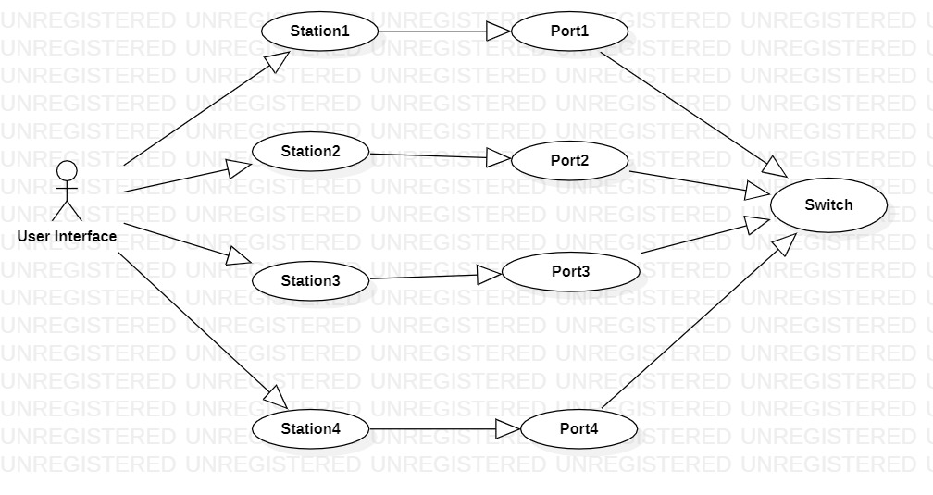
USECASE DIAGRAM

Slide 11
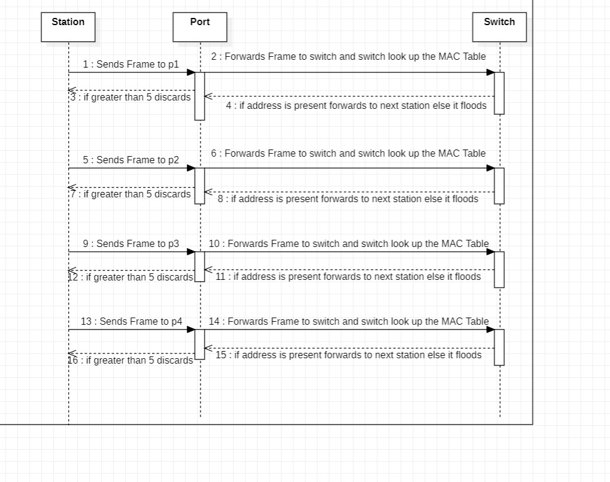
SEQUENCE DIAGRAM

Slide 12
Conclusion
We have developed a project on simulation of switching functionality.
Implemented using c++ and System Programming concepts.
Here we used switch for forwarding or discarding the frames.
We used 4-ports which are connected to stations for sending and receiving the frames.

Slide 13


